Slide 1
Residency Academic Orientation
Spring 2018

Slide 2
Objectives for Today
Introductions
Understand how a Residency differs from a Paid Internship
Understand different components of the Residency Course
Fieldwork requirements
Ethical responsibilities
Learning from Experience
Goal-setting
Reflection
Feedback and Assessment
Coaching
Understand when and how to ask for help

Slide 3
INTRODUCTIONS
Name
Where you will be working
What you will be doing

Slide 4


How does a Residency Differ from a Paid Internship? (Other than not getting paid.)

Slide 5

A Residency is Focused on YOUR LEARNING

Slide 6
Desired Learning Outcomes of Residency
Lawyering Tasks – Complete basic lawyering tasks in a timely fashion and in the context of professional environment
Problem Solving – Handle basic legal problems arising from novel facts in a structured environment
Communication – Expand and refine written and oral communication skills in the context of professional environment
Judgment – Think strategically to respond to a legal problem in a structured environment
Ethics – Demonstrate understanding of ethical obligation in the representation of a client
Professionalism – Develop professional and ethical relationship with colleagues, clients and supervisors

Slide 7
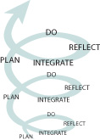
Learning from Experience: The Process

Slide 8
Step One: Plan
Learning Goals and Plan
Set goals
Identify objectives
Set benchmarks
Complete in consultation with Site Supervisor and Faculty Supervisor
Draft plan
Review it with Site Supervisor
Revise it
Upload to TWEN and review with Faculty Supervisor
Revise it
Upload to TWEN

Slide 9
Step One: Plan
How to identify individual goals
What do you want to do with your law degree?
What are the essential lawyering competencies (knowledge, skills and values) necessary for accomplishing your career goals?
Where are you currently in developing these competencies?
Which skills do you or other perceive as your weakest and in the most need of further development?
Which skills are you least likely to acquire in your other courses in law school?
What opportunities do your residency give you to improve on these competencies?

Slide 10

Step One: Plan
Learning Goals and Plan
Set goals
Identify objectives – specific work assignment and experiences that you think will help you attain your goals

Slide 11

Step One: Plan
Learning Goals and Plan
Set goals
Identify objectives
Set benchmarks
The measure of whether the goal has been met

Slide 12
Example from Student A
GOAL 1: Improve client interviewing skills
Objective 1: Read recommended materials on client interviewing
Objective 2: Observe at least 2 client conferences and interviews
Objective 3: Plan for and conduct at least 2 client interviews
Objective 4: Memorialize interviews
Objective 5: Get feedback
Benchmark for Goal 1:
a. Positive feedback from supervisor and, if possible, from clients
b. Produce Interviewing Checklist

Slide 13
Example from Student A
GOAL 2: Develop network of professionals in my field
Objective 1: Meet at least 5 lawyers and others in my field
Objective 2: Ask to attend attorney meetings with my supervisor
Objective 3: Develop list of contacts.
Objective 4: Make favorable impression on others
Benchmark for Goal 1:
a. List of contacts who know me and have favorable impression.
b. Have at least one lawyer willing to write positive recommendation

Slide 14
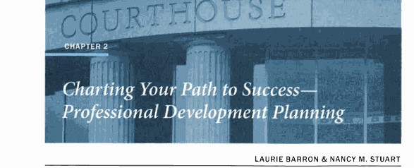
Resource

Slide 15
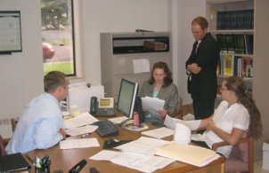
Step Two: Do
Hours
45 hours per credit
7 credits = 315 hours
8 credits = 360 hours

Slide 16
Step Two: Do
Timekeeping
General description of tasks with time for each
Tenths of hour
Multiple hours for one day
Example
7.5 total hours in a day,
3.5 hours research for attorney X on housing law
.8 meeting with attorney X
.2 email to client
3 hours draft memorandum

Slide 17
Step Two: Do
ABA Requirement for Academic Credit:
Substantial lawyering experience reasonable similar to the experience of a lawyer advising or representing a client or engaging in other lawyering tasks
Under the direct supervision of an attorney or judge

Slide 18
The Fundamental Tasks of a Lawyer *MacCrate Report, American Bar Association, 1992
Problem Solving
Legal Analysis and Reasoning
Factual Investigation
Legal Research
Communication
Counseling
Negotiation
Understanding of Options of Litigation and Alternative Dispute Resolution
Administrative Skills Necessary to Organize and Manage Legal Work Effectively
Recognizing and Resolving Ethical Dilemmas

Slide 19
How to get good supervision
Ethics
Alert
NC Rule of Professional Conduct 1.1 -- Competence
A lawyer shall not handle a legal matter that the lawyer knows or should know he or she is not competent to handle without associating with a lawyer who is competent to handle the matter. Competent representation requires the legal knowledge, skill, thoroughness, and preparation reasonably necessary for the representation.

Slide 20
Make sure you understand assignments from the beginning!
REMEMBER
Elon Law Librarians are available to help with research questions

Slide 21
Seek feedback on all assignments
In a timely manner
Set appointment
Be prepared
Ask for examples when not clear
Keep the lines of communication open
Be appreciative

Slide 22
Also ask for Feedback or Clarification When . . . .
You think that your supervisor is not as engaged as you would expect
You see body language or passive behavior that gives you a clue that something may be wrong
You have something specific you’re working to improve

Slide 23
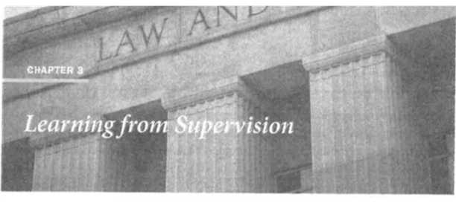
Resource

Slide 24

Step Three: Reflect
Give Meaning to Observations and Experiences

Slide 25

The Best Lawyers are Reflective Lawyers
Do
Plan
Reflect
Integrate

Slide 26

Reflection for Lawyers
A process for developing professional knowledge, expertise, and judgment
Building expertise is a process of adjustments
“Each step you take builds on your experience and builds your experience.”

Slide 27

Tools to Aid Reflection
Weekly Learning Journal
Feedback from Site Supervisor
Self-Assessment
Coaching from Faculty Supervisor

Slide 28

Reflective Lawyering Tool:
The Learning Journal

Slide 29
The Role of Journaling in Learning *Benjamin Bloom on mastery learning
Enables complex inquiry
Writing creates knowledge
Memorializes reflection on experience
Therapeutic
Enhances observation skills

Slide 30
Residency Journal Entry
Begin with Prompts
record your own thoughts, ideas, responses and reactions
Add other reflections
Accomplishments, challenges, observations
Should reach a deeper level of understanding through process of analyzing questions and experiences

Slide 31
Rule 1.6: Confidentiality of Information
A lawyer shall not reveal information acquired during the professional relationship with a client unless
Client’s informed consent to disclosure
Impliedly authorized to carry out representation
Stated exceptions in (b)
Ethics
Alert

Slide 32
“Shop Talk”
Unless told otherwise by supervising attorney
Avoid disclosure of identifying client information. Take context into account.
Couch problems in hypothetical questions

Slide 33

Resource

Slide 34


Stage Four of Learning
Integrate & Improve

Slide 35
Academic Schedule
Orientation
Two Faculty-Resident Conferences
Two Affinity Group Meetings
Mid-Term
Evaluation by Site Supervisor
Site and Faculty Supervisors Conference
Final Evaluation by Site Supervisor
WEB-EX

